Slide 1
Connecting to the Internet
Lecture 9

Slide 2
Connecting to the Internet
We need to configure our system before that connection can take place.
Enter the Internet Configuration Wizard
(Main Menu | System Tools | Internet
Configuration Wizard):

Slide 3
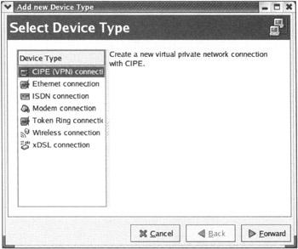
Connecting to the Internet

Slide 4
Network Configuration Tool
Bypass the connection wizard and come directly to this tool, as your first port of call.
It can be accessed from the
Main Menu by selecting
System Settings | Network:

Slide 5
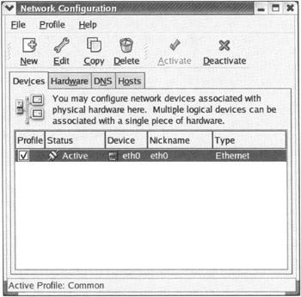

Slide 6
Analog Modem Connections
using an analog modem attached to a phone line
An internal modem, usually as a modem card
Built into the motherboards,
or operated through software (so called
'soft−modems').

Slide 7
Technical Operation
when you use your analog modem to connect to the Internet.
Typically your modem connects to a phone line and dials out to a phone number provided by your ISP.
Most commonly, the protocol used on the wire is PPP (point to point protocol).
The TCP/IP protocol is then layered on top of this PPP protocol layer.

Slide 8
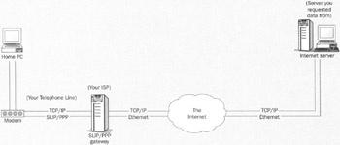
Once your machine has successfully connected to the gateway interface at your ISP, it is then connected to the Internet, and you can send and receive information:

Slide 9

Connecting an Analog Modem to the Internet
Move to the Devices tab, and select New in the Network Configuration tool:

Slide 10
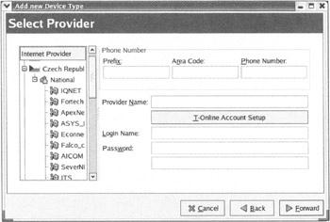
Choose the Modem connection option, then press Forward to reach the following screen:

Slide 11
In this screen, we can either choose from the expandable list of ISPs on the left, or enter our own dial−up information into the boxes provided on the right.
To turn on your Internet connection, select your newly created device, and then click the Activate button at the top of the panel.
To turn it off, simply click the Deactivate button

Slide 12
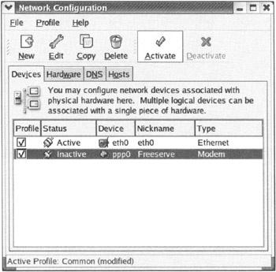

Slide 13
Connecting a High Bandwidth Connection to the Internet
  Choose xDSL connection from the Internet Configuration Wizard.
  Enter your account details such as the Provider Name together with your Login name and Password:
  Select Forward, then Apply, to finalize your configuration

Slide 14
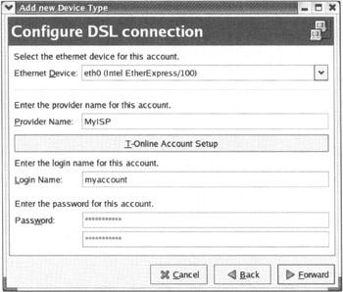

Slide 15
Connecting to a LAN
Static addresses are allotted to machines indefinitely and do not change. Typically static addresses are allocated to servers.
Dynamic addresses are allotted to machines for a specific period with no guarantee that the same address will be available next time the machine connects to the network

Slide 16
the address is allocated either using the
Dynamic Host Configuration Protocol (DHCP)
Bootstrap Protocol (BOOTP).

Slide 17
For a machine connected to a LAN or ISP using a static IP address,
obtain the network details
  such as the IP Address
  the Subnet Mask for the network
  the Default Gateway Address which is the IP address of a router for the network.
  The local network administrator (or the ISP) should be able to provide these details.

Slide 18
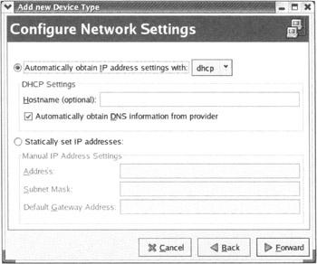

Slide 19
Domain Name System (DNS)
  Easy to remember than IP addresses
Other Connection Types
  The Internet Connection Wizard also allows us to configure some of the less common types of connection devices
  such as ISDN and Token Ring adapters:

Slide 20
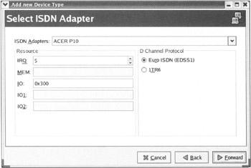
Other Connection Types

Slide 21
Other Connection Types
Wireless Connections
    Wireless cards and VPN connections. Most of the popular wireless cards provide connectivity using the 802.11b protocol and are known as Wireless Ethernet devices.
    VPN (Virtual Private Network) connections allow us to securely connect to a corporate network via the public Internet.

Slide 22
Other Connection Types
    In other words, typical VPN users connect to work over the Internet either from home or while on the road by using a VPN connection which provides an encrypted channel of communication.
CIPE (Crypto IP Encapsulation) is a Linux implementation of VPN access software.

Slide 23

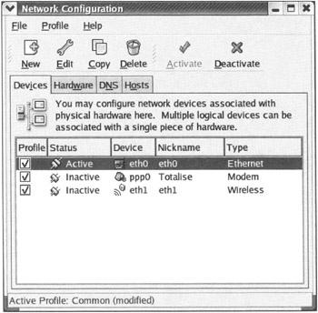
Managing Multiple ISPs and Connections

Slide 24
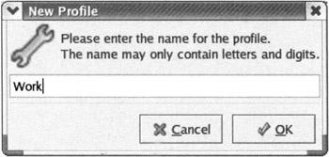
Managing Multiple ISPs and Connections
Create the required profiles using the following steps:
  1. Choose Profile from the drop−down menu, and select New.
  2. Enter Work in the pop−up box that appears:

Slide 25
Managing Multiple ISPs and Connections
  3. Now that we have our profile created
  4. Highlight the physical device eth0 and click Copy.
  5. Select the copy, and click the Edit button and specify the nickname eth0_work along with other
  properties such as the DNS server to be used and the IP address (you can make these up for the purposes of the demonstration).
  Finally click OK

Slide 26
Managing Multiple ISPs and Connections
6. Finally, add the newly created logical device to the Work profile by marking the Profile checkbox on the left−hand side for those logical devices that belong to the profile.
7. To save our changes we need to click the Apply button.
A logical device may belong to only one profile.

Slide 27
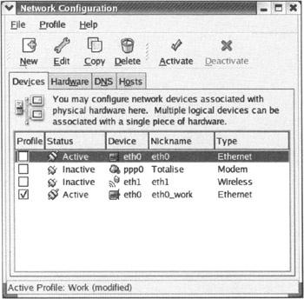
Managing Multiple ISPs and Connections

Slide 28
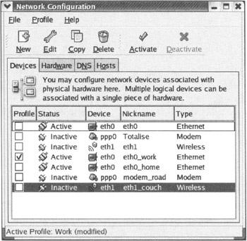
Managing Multiple ISPs and Connections
8. We can use the same routine to create profiles for our Home, Road, and Couch accounts:

Slide 29
Starting Connections
Some of them, such as the Ethernet device, remain connected (or activated) as long as they are physically connected to the network.
Others such as a modem need to be activated on an as−needed basis.
  Main Menu and choose System Settings | Network,
highlight the appropriate connection, and click on Activate.
to automatically establish a modem connection when needed, using a daemon called diald

Slide 30
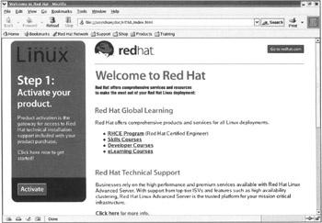
Web Browsers
The most common and popular way of accessing the Internet is by using a web browser.
Red Hat Linux 9 comes with the highly functional Mozilla browser installed by default

Slide 31
Mozilla Proxies
Collect the information from whoever supervises our network:
  The DNS name of the proxy and the port number it listens at for HTTP connections.
  Most of the time the same proxy server handles other protocols such as SSL, FTP, Gopher, and SOCKS.
  If we intend to use any of these protocols, we need to get the address of the proxy server for each of these protocols and the port at which they listen for incoming requests.

Slide 32
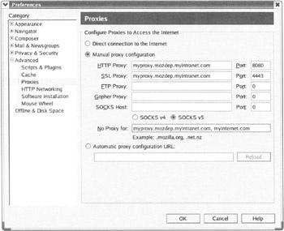
Mozilla Proxies
fire up Mozilla, and open Edit | Preferences | Advanced | Proxies:

Slide 33
Configuring Mozilla
Privacy and Security Settings
  allow us to browse the web without being bothered by security concerns or prying eyes.
Pop−up ads:
  We are annoyed by the often−distracting pop−up advertisements that appear when we attempt to load a page.
  These can be blocked by choosing the menu item Edit | Preferences | Advanced | Scripts & Plugins and unchecking Open unrequested windows.

Slide 34
Blocking ad images:
  the other annoying mode of online advertisement is banner advertisements that are served up by online ad−banner companies that embed links to images in web pages.
  These ads can be blocked by right−clicking the ad image and selecting Block images from this server.
  We could reinstate permissions to allow a blocked server to display its images from the Tools | Image Manager |

Slide 35
Browsing and Appearance
  Mozilla allows us to customize our browsing experience by providing a tabbed browsing interface and also the ability to change the appearance of the browser itself.
Tabs rather than Windows:
  Using tabs to browse is faster and results in less clutter than using new windows
  every time we needed to have multiple pages open at the same time (look at the top of the page, just below the Bookmarks line):

Slide 36
Tabs rather than Windows:
We can open a new tab with the Ctrl+T or Open Link in New Tab.
Further, if we enable the Middle−click or Control−click of links in a web page option, we can open links in new tabs by clicking links using the middle mouse button or a Ctrl +left−click of the mouse.
These options are available from the Edit | Preferences | Navigator | Tabbed Browsing menu.

Slide 37
  From the same menu, by enabling Ctrl+Enter in the location bar option, we can open a location in a new tab by typing in the URL followed by Ctrl+Enter.
Themes:
  Mozilla has the classic theme and a modern theme available by default, and new themes can be downloaded from http://www.mozdev.org.
  the menu option View | Apply Themes

Slide 38
Auto−completion:
  Edit | Preferences | Navigator | Smart Browsing menu is checked.
Installing Plug−ins
  Mozilla by default does not have plug−ins installed.
E−mail and News Clients
  The default e−mail client is Ximian Evolution

Slide 39
The Ximian Evolution Client
The Ximian Evolution client is similar in both look−and−feel and functionality to Microsoft Outlook minus the virus issues commonly associated with Microsoft's e−mail clients.
The Evolution client also integrates a calendar and contacts management software.
On starting Evolution for the first time from the panel, a wizard will prompt us to enter account information for our e−mail.

Slide 40
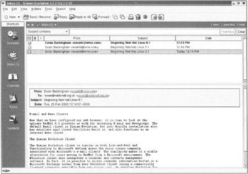
The Ximian Evolution Client

Slide 41
Accessing Microsoft Exchange Mall from Ximian
A server that allows users to manage and share calendar events, contacts, e−mail, and even files.
The Exchange server is designed to work primarily with Microsoft Outlook and quite often it is not configured to allow clients to
access e−mail using the POP or IMAP protocols.
However, Ximian provides a commercially licensed connector to access e−mail from an Exchange server.
It should be noted that if POP access is enabled.

Slide 42
E−mail and News Clients connector is not required if we use the Microsoft Exchange server only for e−mail.
We definitely need the connector if we rely on a Microsoft Exchange server for calendar and file−sharing features.

Slide 43
To configure Ximian
1. The mail user's full name.
2. The login name for the Exchange server.
This is usually the part of the e−mail ID preceding the @ symbol, also known as the mail user ID.
3. If the mail user ID is different from the login name, we need to provide that id as the mailbox name.
4. The DNS name of the Exchange server

Slide 44
If an LDAP−based corporate directory server such as the Netscape Directory Server is deployed locally,
the DNS name of the server can be entered to look up contacts using LDAP.
LDAP stands for Lightweight Directory Access Protocol.

Slide 45
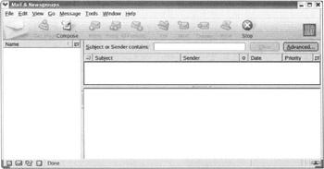
The Mozilla Mail Client

Slide 46
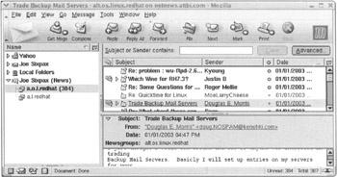

Slide 47
Switching Mall Transfer Agents
Mail transfer agents (MTAs) relay outgoing mail to its destination using the SMTP protocol.
Red Hat Linux 9 comes with a choice of two mail transfer agents, Sendmail and Postfix.
The Mail Transfer Agent Switcher tool can be accessed from the Main Menu | System Settings | Mail Transfer Agent Switcher.
We can switch the MTA to be used, by clicking the appropriate radio button and then selecting Apply.

Slide 48
Other Software
FTP Clients
  The gFTP tool (Graphical FTP) available with Red Hat Linux 9 installations is a graphical FTP tool that has several power features lacking in the other clients.
  The gFTP client can be started from the Main Menu | Internet | More Internet Applications | gFTP,
  Or by typing gftp at the command line:

Slide 49
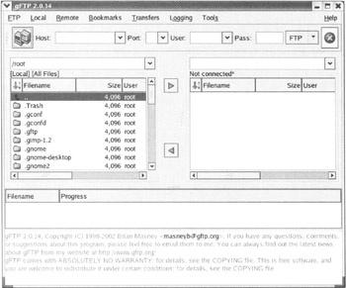

Slide 50
Xchat
IRC or Internet Relay Chat is the predecessor of peer−to−peer and instant messaging systems of today.
Red Hat Linux 9 comes with an IRC client called Xchat that can be accessed from the
  Main Menu | Internet | More Internet Applications | Xchat menu:

Slide 51
Instant Messaging
instant messaging applications allow users to chat one−on−one or in a group in real time as well as allow them to share files.
All of the instant messaging applications are not based on a common protocol, but on proprietary protocols that do not interact with each other.
AIM (AOL's instant messaging solution) cannot seamlessly connect with a user on a different messaging network, say Yahoo! Messenger.
This is where Gaim comes in.

Slide 52
Gaim is an instant messaging client that supports multiple protocols
allows a user to be logged on to different networks with different account names simultaneously.
Gaim can be invoked from Main Menu | Internet | Instant Messenger:

Slide 53
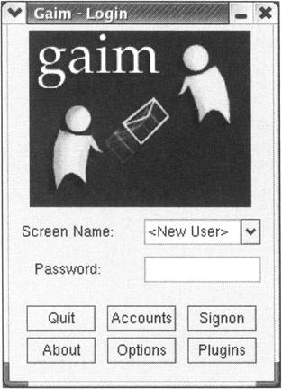
GAIM

